Slide 1
CAREC Mid-Term Report on Achieved Results (May 2024 – March 2025)
Consulting Services for Regional Collaboration
March 12, 2025
online

Slide 2
TAJIKISTAN RESILIENT LANDSCAPES RESTORATION PROJECT
Sub-component 1.2. Strengthen Regional Collaboration
IMPLEMENTING AGENCY:
Center for Implementation of Investment Projects of the Committee for Environmental Protection under the Government of the Republic of Tajikistan
SUBCONTRACT AGENCY:
The Regional Environmental Centre for Central Asia
CONTRACT PERIOD:
May 2024 – September 2027
BUDGET:
US $ 1,807,547.00 from IDA
Promote Tajikistan’s collaboration with Central Asian countries on transboundary cooperation and landscape restoration, given the critical need to address emerging threats at the regional level, including impacts of climate change.
OBJECTIVE:

Slide 3
PLANNED ACTIVITIES
Sub-component 1.2. Strengthen Regional Collaboration
1
Regional Knowledge Exchange Platform on Rehabilitation of Sustainable Landscapes
2024-2027
4
International conferences participated by CEP
(5 participants each)
2024, 2025, 2026, 2027
5
Study Tours for CEP staff
(7 participants each)
2024-2027
6
Development of Harmonized Policy Documents
2024-2027
Baseline
End Target
0
6
2
Central Asia Climate Change Conferences (CACCC)
(100 participants each)
2025, 2026
4
Regional thematic activities on the harmonized policies
(50 participants each)
2024, 2025, 2026, 2027
8
Regional Advisory Committee meetings (RAC)
2024, 2025, 2026, 2027
Overall Coordination
Coordination of regional component under the RESILAND CA+ Programme
Monitoring, Evaluation, and Reporting
Quarterly reports on implemented activities with statistic and visual graphics

Slide 4
CAREC STAFF
Center for Implementation of Investment Projects
The Regional Environmental Centre for Central Asia
Key Experts
Non-Key Experts
Team Leader
International relations specialist
International PA/forest management specialist
Deputy Team Leader
Financial management specialist
Forest management specialist
Environmental and social specialist
M&E and Reporting Officer
Biodiversity Specialist
Pasture management specialist
Legal specialist
PR and Communication Specialist
Knowledge Management Specialist
Policy development specialist

Slide 5
RESILAND REGIONAL ADVISORY COMMITTEE (RAC)
Structure of the Regional Advisory Committee
Kazakhstan
Kyrgyzstan
Tajikistan
Turkmenistan
Uzbekistan
RESILAND Coordinating Agency KZ
RESILAND Coordinating Agency KG
RESILAND Coordinating Agency TJ
RESILAND Coordinating Agency TM
RESILAND Coordinating Agency UZ
PA / Forestry Agency KZ
Monitoring Department of MoES
PA / Forestry Agency TJ
PA / Forestry Agency TM
PA / Forestry Agency UZ
RESILAND KZ Coordinator
RESILAND KG Coordinator
RESILAND TJ Coordinator
RESILAND TM Coordinator
RESILAND UZ Coordinator
Observer
Secretary
World Bank
CAREC

Slide 6
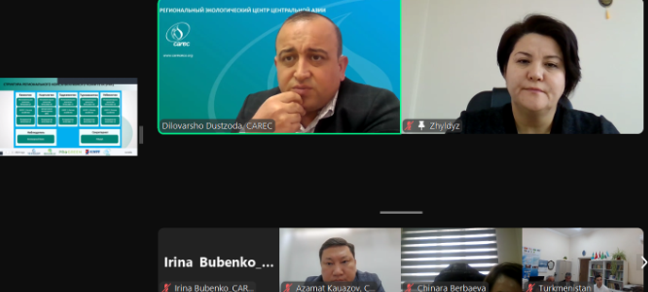
RESILAND REGIONAL ADVISORY COMMITTEE (RAC) MEETINGS
DECISIONS:
Approve the RAC regulation taking into account the Kyrgyz Republic’s comments;
Elect the Republic of Uzbekistan as the RAC Chairman for 2024;
Take into account the CAREC approach to the implementation of regional components;
Take into account the information on the conduction of CACCC 2025 in Ashgabat, Turkmenistan;
Organize the third RAC in offline format in May 2025 within the CACCC 2025;
CAREC send the draft of 6 harmonized policies by mid-January to all CA countries;
Countries will send comments on harmonized policies in the fastest possible period;
Countries undertake to send materials to CACIP.
October 10, 2024
Tashkent, Uzbekistan
First RAC:
December 10, 2024
Online
Second RAC:

Slide 7
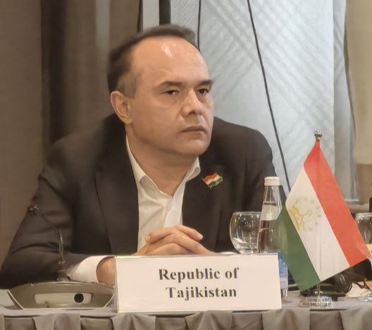
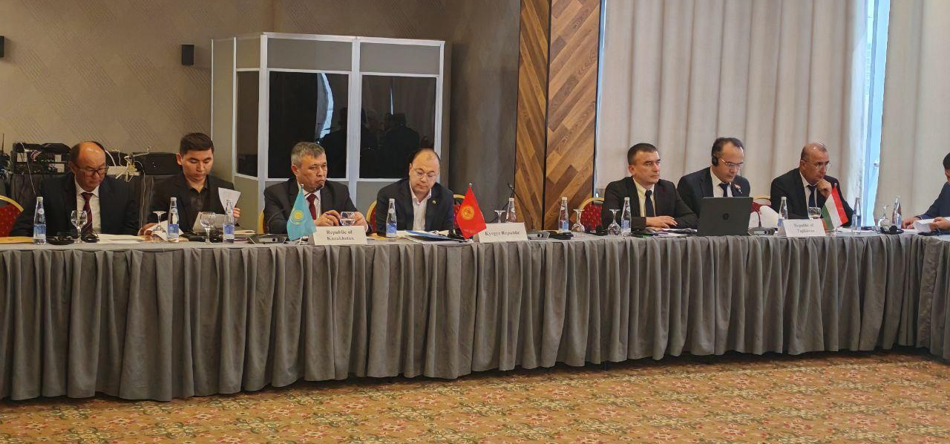
Regional Meeting “Harmonized policies and approaches to restoration of transboundary landscapes”
October 10, 2024
VENUE:
Tashkent, Uzbekistan
Discussion of national and regional components implemented within the framework of the RESILAND CA+ program.
Harmonization of policies for natural resource management and landscape restoration.
Strengthening regional cooperation on transboundary landscape management issues.
KEY OBJECTIVES:

Slide 8
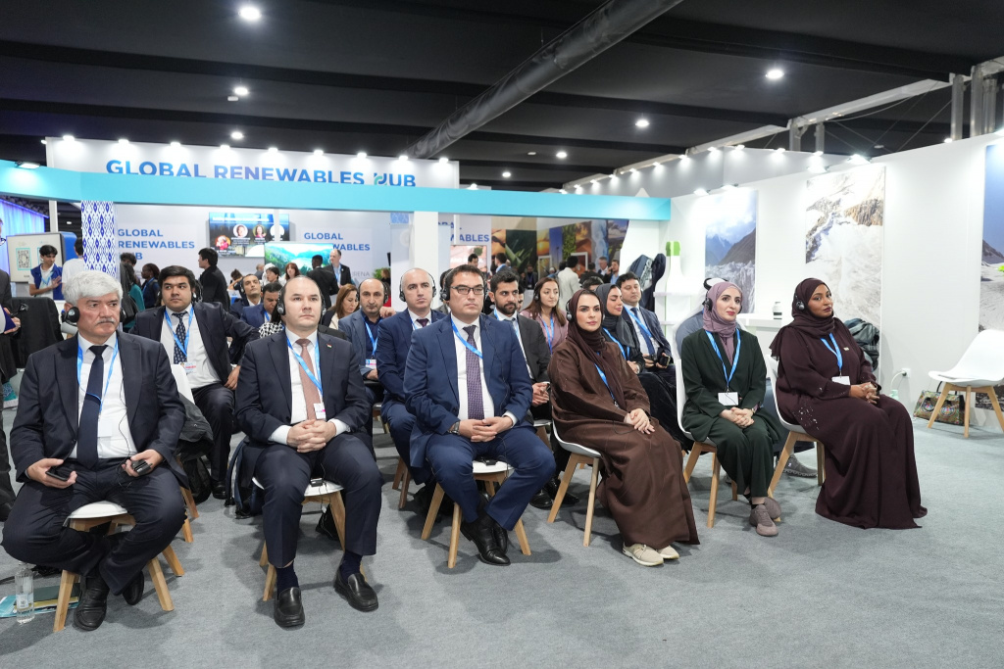
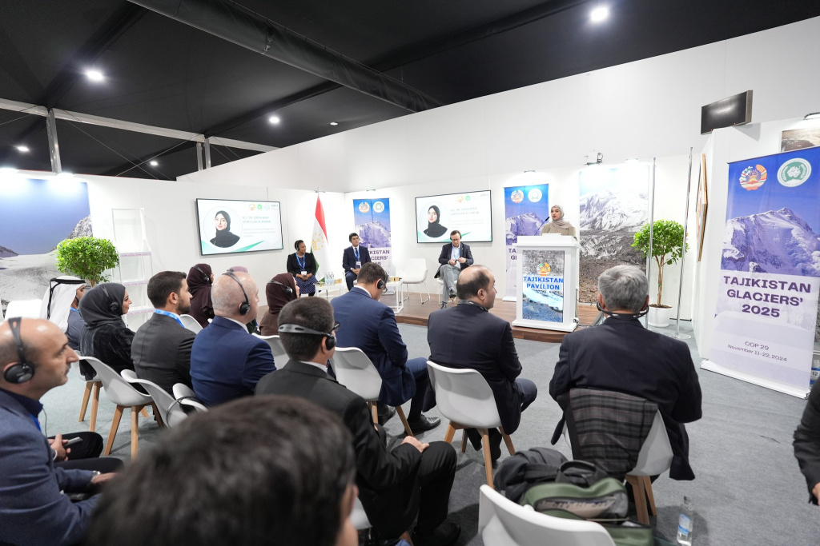
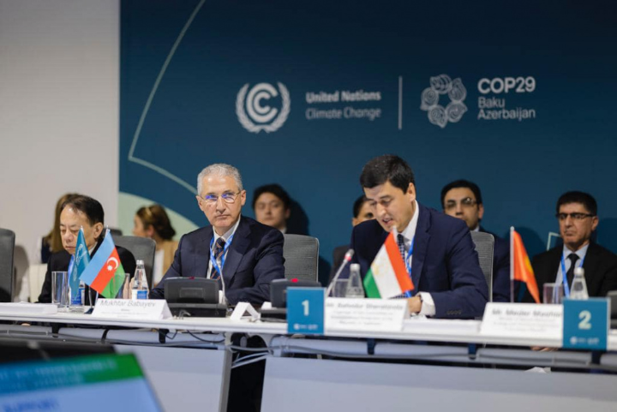
Support the participation of CEP delegation in UNFCCC COP 29
November 10-22, 2024
VENUE:
Baku, Azerbaijan
PARTICIPANTS:
CEP – 5, CAREC – 1
Supporting the participation of the CEP delegation in international conferences on environmental and climate change issues
PARTNERS:

Slide 9
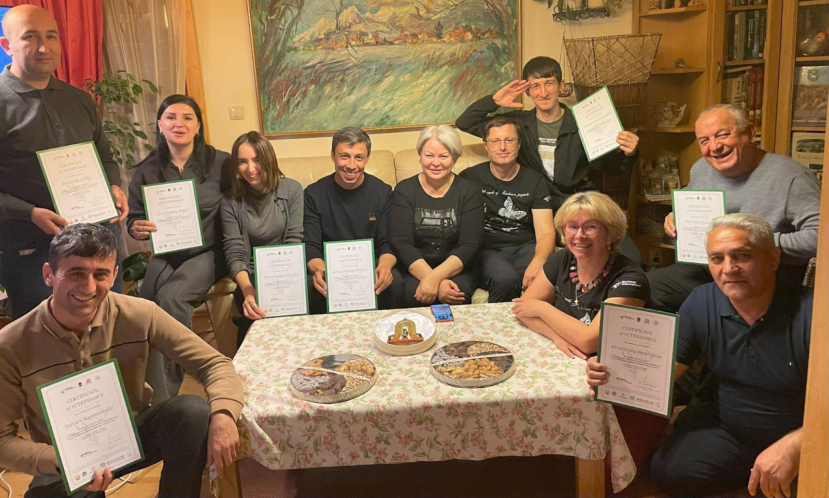
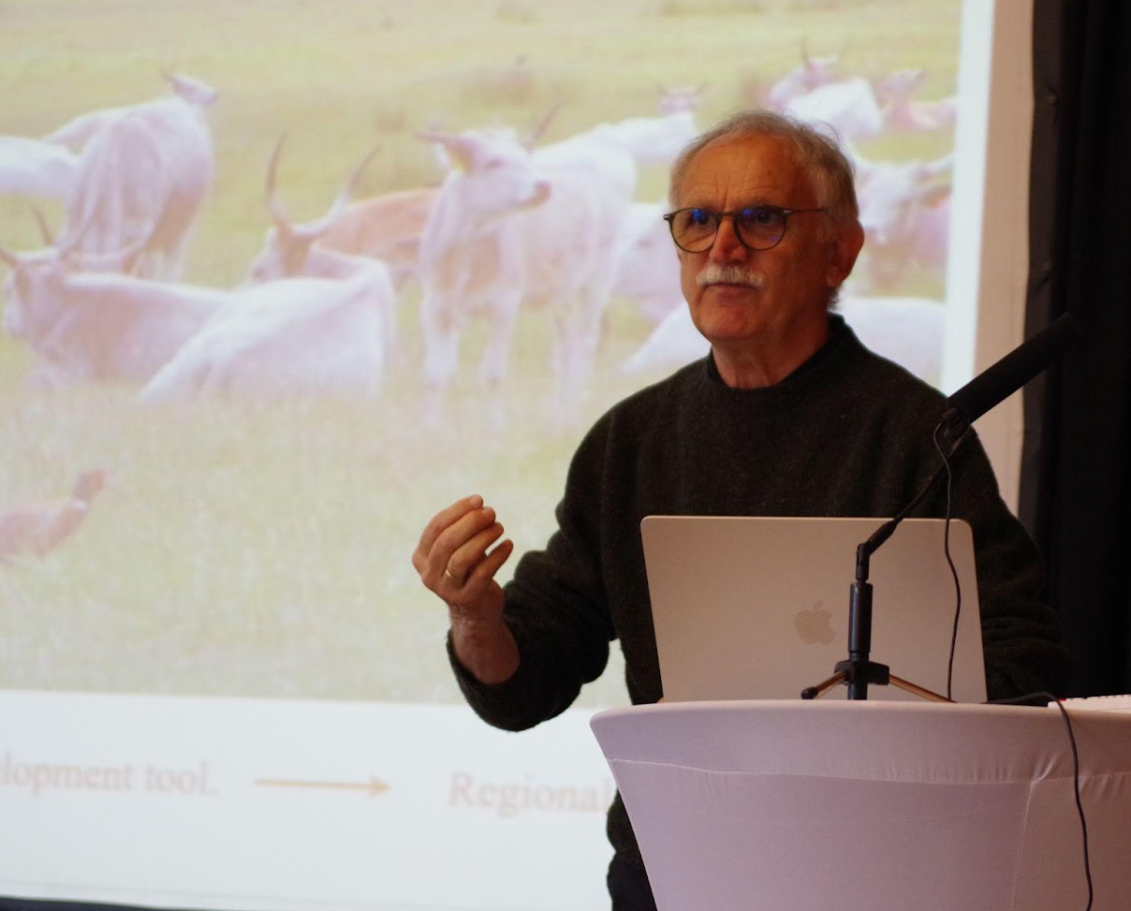
Study Tour “Innovative approaches to management and conservation of biodiversity in European National Parks”
October 26 – November 3, 2024
VENUE:
Austria, Czech Republic, Slovakia
PARTICIPANTS:
CEP – 7, CAREC – 2
Machaon International (Slovakia)
Neusiedler See National Park (Austria)
Local initiative group Straznicko (Czech Republic)
National Park "Slovenian Paradise" (Slovakia)
PARTNERS:

Slide 10
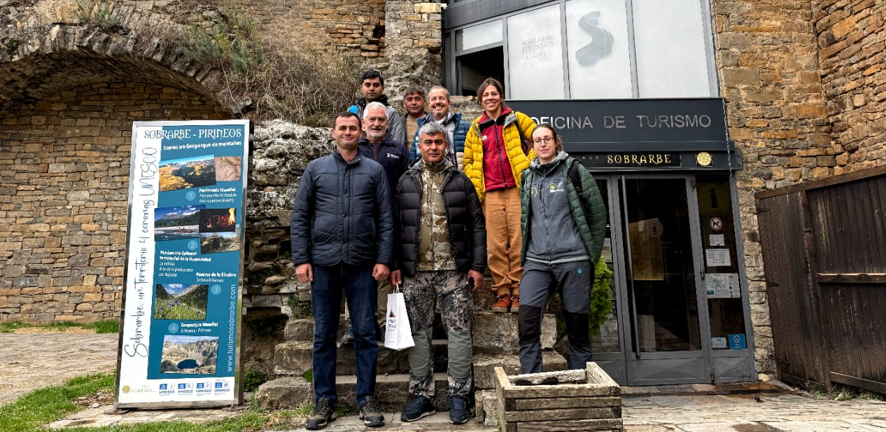
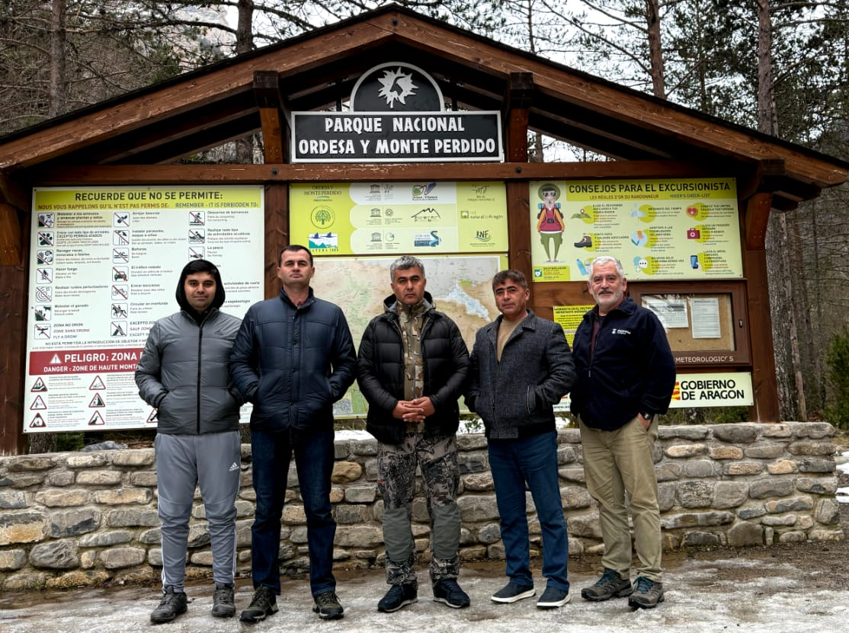
Study Tour “Ecological monitoring of endangered species in protected natural areas”
March 1 – 9, 2025
VENUE:
Spain
PARTICIPANTS:
CEP – 4
University of Zaragoza
Administration of the Aragon region (Spain)
PARTNERS:

Slide 11
HARMONIZED POLICY
Sent to all CA countries and RAC members for comments
STATUS:
MoU on Unified Inventory Methods for Flora, Fauna, and Ecosystem Monitoring in Transboundary Corridors
MoU on Cross-Border Access for Nature Tourism in Protected Areas and Unique Natural Sites
MoU on the Establishment of a Transboundary 'Peace Park’
Protocol on Nature-Based Solutions for Erosion Control and Road Resilience
Joint Plan for Transboundary Wildlife Corridors and Cooperation on Species and Habitat Protection
Regional Wildfire Alert System or Protocol
DOCUMENTS:

Slide 12
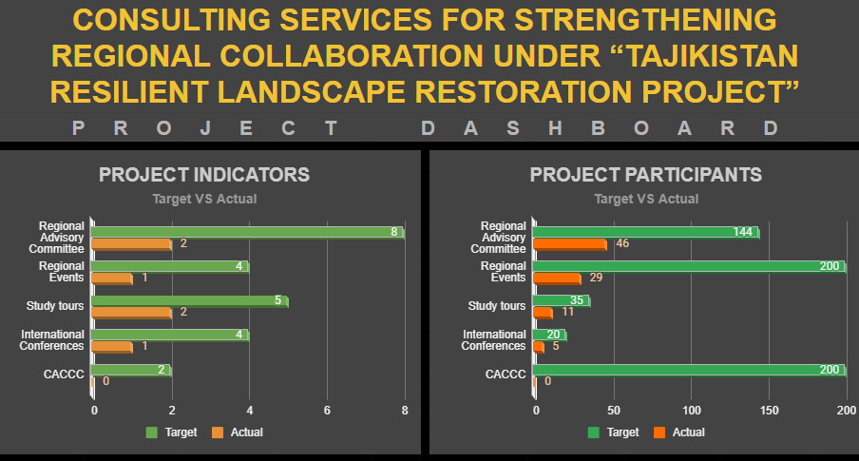
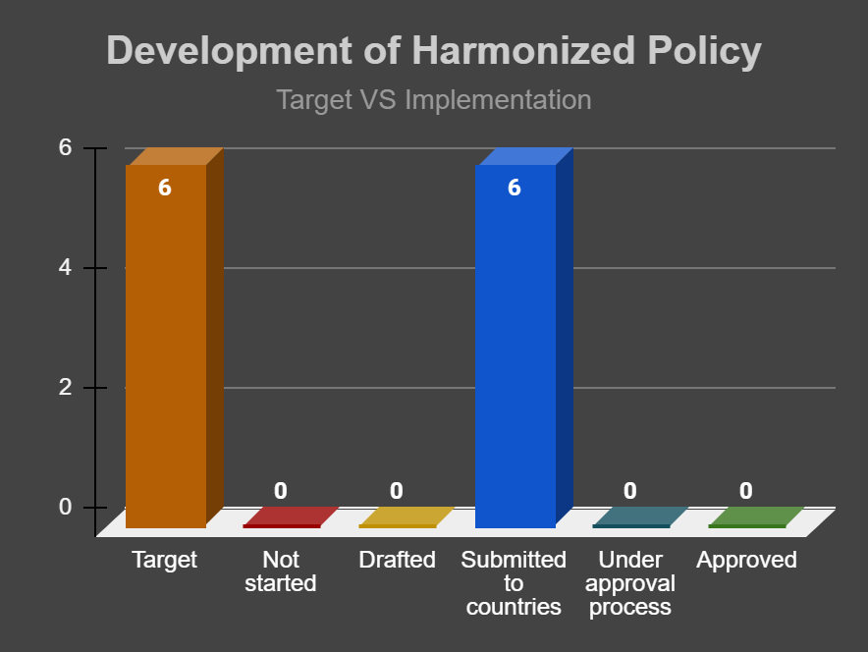
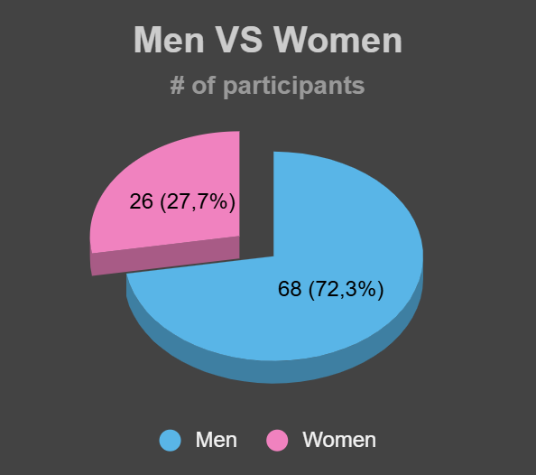
RESILAND TJ REGIONAL COMPONENT M&E SYSTEM
LANGUAGE:
English, Russian, Tajik
User Guide
Project Information (project background, contact information from CEP and CAREC)
Dashboard with visualization (graphs, maps)
Statistics (participants disaggregated by sex, uniqueness, events, countries, type of organization)
Link to documents (harmonized policies, expert reports, project reports)
Events (Agenda, List of participants, reports/minutes)
Participant details (name, position, organization, contacts)
CONTENT:

Slide 13
RESILAND TJ NATIONAL COMPONENTS M&E SYSTEM
Indicators under discussion:
Areas and territories (by type of practice: forests, pastures, protected areas...)
Project beneficiaries by territory, gender, and type of practice
Number of people trained (by area and gender);
Women's participation (by type of involvement in training, sub-grants, participation in assessments, planning...);
...
Next steps:
Harmonize data for merging at the regional level;
Coordinate dashboards for placement at CACIP;
Identification of a responsible person from PIU;
Development of a format, an M&E database in Google, and a user manual.

Slide 14
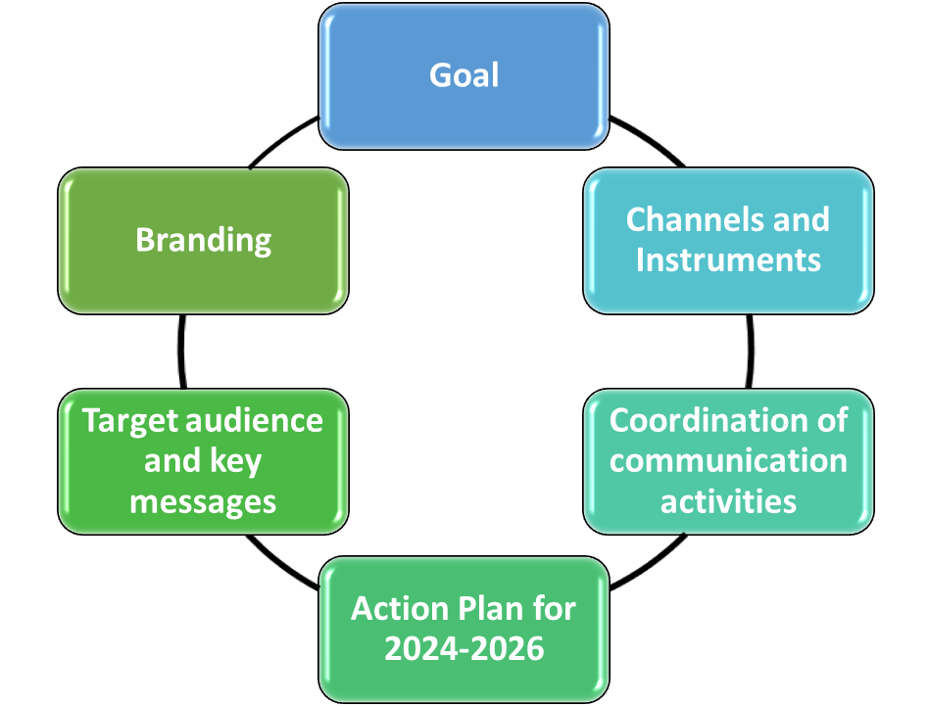
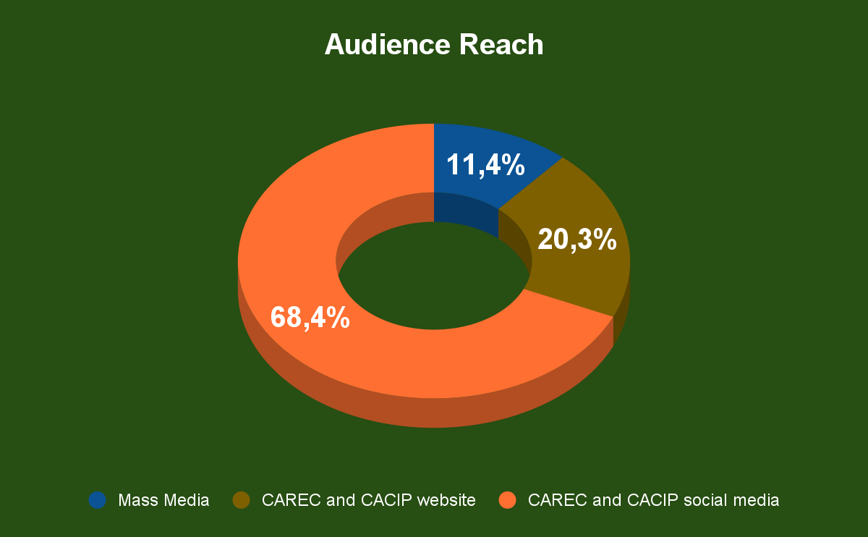
RESILAND CA+ COMMUNICATION STRATEGY
Communication means | Publication | Audience Reach
Mass Media | 9 | 2181
CAREC and CACIP website | 16 | 536
CAREC and CACIP social media | 54 | 4509
TOTAL: | 79 | 7226
STATUS:
Submitted to WB for comments
CONTENT

Slide 15
REGIONAL KNOWLEDGE EXCHANGE PLATFORM
Knowledge Management Portal
Goal:
Organizing knowledge: Development of a system for classifying and storing knowledge
Increasing accessibility: Creating a structure for quickly finding and analyzing information
Process optimization: Reducing time spent accessing relevant data
Link:
Data collection
Integration into the database
Content analysis
Knowledge codification process
Objective:
Knowledge identification: Identifying and classifying existing textual materials.
Classification: Division of knowledge into types, topics, and levels of detail.
Creating a database: Forming a platform for storing and using knowledge.
Developing a codification methodology: Defining standards for classification and recording.
Unification of recording format
Classification

Slide 16
WORK PLAN FOR 2025
No. | Activities | Time frame
1 | Central Asia Climate Change Conference | May 2025
2 | 3rd RESILAND Advisory Committee (RAC) - offline | May 2025
3 | 4th RESILAND Advisory Committee (RAC) - online | November – December 2025
4 | Regional meeting on Harmonized Policies | May 2025
5 | 2nd Study Tour for CEP staff | March 2025
6 | 3rd Study Tour for CEP staff | May – June 2025
7 | 4th Study Tour for CEP staff | August – October 2025
8 | Support the CEP staff to participate in International Conferences | October – December 2025
9 | Development of zero draft text of Harmonized Policy and submission to CA countries | January – April 2025
10 | Development of the final draft text of Harmonized Policies in accordance to the comments from CA countries | May – July 2025
11 | Submission of the final draft text of Harmonized Policies to CA countries for approval | August – October 2025

Slide 17
UZBEKISTAN RESILIENT LANDSCAPES RESTORATION PROJECT
Sub-component 1.3. Strengthen Regional Collaboration
IMPLEMENTING AGENCY:
Forestry Agency under the Ministry of Ecology, Environmental Protection and Climate Change of the Republic of Uzbekistan
SUBCONTRACT AGENCY:
The Regional Environmental Centre for Central Asia
IMPLEMENTING PERIOD:
2025 - 2028
US $ 1,0 mln from IDA
BUDGET:
US $ 1,0 mln from PROGREEN
Promote Uzbekistan’s collaboration with Central Asia countries on transboundary cooperation and landscape restoration, given the critical need to address emerging threats at the regional level, including impacts of climate change.
OBJECTIVE:

Slide 18
PLANNED ACTIVITIES
Sub-component 1.3. Strengthen Regional Collaboration
Development of sustainability plan for the continued operation
Development of Regional online database
Operation and Maintenance
85%
Start
Mid-Term
End
Mid-Term online survey on users’ satisfaction
Final online survey on users’ satisfaction
2
4
Regional thematic activities on the development of a regional online database
2025, 2026, 2027, 2028
8
Central Asia Climate Change Conferences (CACCC)
2027, 2028
Regional Advisory Committee meetings (RAC)
2025, 2026, 2027, 2028
Overall Coordination
Coordination of regional component under the RESILAND CA+ Programme
Monitoring, Evaluation, and Reporting
Quarterly reports on implemented activities with statistic and visual graphics

Slide 19
KYRGYZ REPUBLIC RESILIENT LANDSCAPES RESTORATION PROJECT
Sub-component 1.3. Strengthen Regional Collaboration (Set 1)
IMPLEMENTING AGENCY:
Ministry of Emergency Situations of Kyrgyz Republic
SUBCONTRACT AGENCY:
The Regional Environmental Centre for Central Asia
IMPLEMENTING PERIOD:
2025 - 2028
BUDGET:
US $ 1,0 mln from PROGREEN
Promote Kyrgyz Republic’s collaboration with Central Asia countries on transboundary cooperation and landscape restoration, given the critical need to address emerging threats at the regional level, including impacts of climate change.
OBJECTIVE:

Slide 20
PLANNED ACTIVITIES
Sub-component 1.3. Strengthen Regional Collaboration (Set 1)
Development of an online catalog of current and future
climate disasters
Preparation of guidance and recommendations on NBS
Development of a regional road map to mitigate the consequences of mudflows
4
2
Sessions at International Mountain Conference with CA representatives
2025, 2026
Glaciology Summer Schools in Kyrgyz Republic
2025, 2026, 2027, 2028
Disseminate of the OVOP model to engage communities
3
COPs participated by Kyrgyz Republic delegation
(up to 3 participants each)
2025, 2026, 2027
4
Regional thematic activities on the development of an online catalog
2025, 2026, 2027, 2028
8
Regional Advisory Committee meetings (RAC)
2025, 2026, 2027, 2028
Overall Coordination
Coordination of regional component under the RESILAND CA+ Programme
Monitoring, Evaluation, and Reporting
Quarterly reports on implemented activities with statistic and visual graphics

Slide 21
THANK YOU!
The Regional Environmental Centre for Central Asia
https://carececo.org/main
https://centralasiaclimateportal.org

